Slide 1
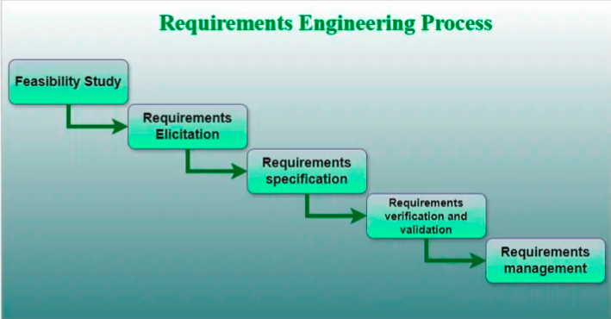
Requirements Engineering
A systematic and strict approach to the definition, creation, and verification of requirements for a software system is known as requirements engineering. To guarantee the effective creation of a software product, the requirements engineering process entails several tasks that help in understanding, recording, and managing the demands of stakeholders.

Slide 2
Feasibility Study
The feasibility study mainly concentrates on below five mentioned areas below. Among these Economic Feasibility Study is the most important part of the feasibility analysis and the Legal Feasibility Study is less considered feasibility analysis.
Technical Feasibility: In Technical Feasibility current resources both hardware software along required technology are analyzed/assessed to develop the project. This technical feasibility study reports whether there are correct required resources and technologies that will be used for project development. Along with this, the feasibility study also analyzes the technical skills and capabilities of the technical team, whether existing technology can be used or not, whether maintenance and up-gradation are easy or not for the chosen technology, etc.
Operational Feasibility: In Operational Feasibility degree of providing service to requirements is analyzed along with how easy the product will be to operate and maintain after deployment. Along with this other operational scopes are determining the usability of the product, Determining suggested solution by the software development team is acceptable or not, etc.

Slide 3
Economic Feasibility: In the Economic Feasibility study cost and benefit of the project are analyzed. This means under this feasibility study a detailed analysis is carried out will be cost of the project for development which includes all required costs for final development hardware and software resources required, design and development costs operational costs, and so on. After that, it is analyzed whether the project will be beneficial in terms of finance for the organization or not.
Legal Feasibility: In legal feasibility, the project is ensured to comply with all relevant laws, regulations, and standards. It identifies any legal constraints that could impact the project and reviews existing contracts and agreements to assess their effect on the project’s execution. Additionally, legal feasibility considers issues related to intellectual property, such as patents and copyrights, to safeguard the project’s innovation and originality.
Schedule Feasibility: In schedule feasibility, the project timeline is evaluated to determine if it is realistic and achievable. Significant milestones are identified, and deadlines are established to track progress effectively. Resource availability is assessed to ensure that the necessary resources are accessible to meet the project schedule. Furthermore, any time constraints that might affect project delivery are considered to ensure timely completion. This focus on schedule feasibility is crucial for the successful planning and execution of a project.

Slide 4
2. Requirements Elicitation
It is related to the various ways used to gain knowledge about the project domain and requirements. The various sources of domain knowledge include customers, business manuals, the existing software of the same type, standards, and other stakeholders of the project. The techniques used for requirements elicitation include interviews, brainstorming, task analysis, prototyping, etc. Some of these are discussed here. Elicitation does not produce formal models of the requirements understood. Instead, it widens the domain knowledge of the analyst and thus helps in providing input to the next stage.
Requirements elicitation is the process of gathering information about the needs and expectations of stakeholders for a software system. This is the first step in the requirements engineering process and it is critical to the success of the software development project. The goal of this step is to understand the problem that the software system is intended to solve and the needs and expectations of the stakeholders who will use the system.

Slide 5
Several techniques can be used to elicit requirements, including:
Interviews: These are one-on-one conversations with stakeholders to gather information about their needs and expectations.
Surveys: These are questionnaires that are distributed to stakeholders to gather information about their needs and expectations.
Focus Groups: These are small groups of stakeholders who are brought together to discuss their needs and expectations for the software system.
Observation: This technique involves observing the stakeholders in their work environment to gather information about their needs and expectations.
Prototyping: This technique involves creating a working model of the software system, which can be used to gather feedback from stakeholders and to validate requirements.

Slide 6
3. Requirements Specification
This activity is used to produce formal software requirement models. All the requirements including the functional as well as the non-functional requirements and the constraints are specified by these models in totality. During specification, more knowledge about the problem may be required which can again trigger the elicitation process. The models used at this stage include ER diagrams, data flow diagrams(DFDs), function decomposition diagrams(FDDs), data dictionaries, etc.
Requirements specification is the process of documenting the requirements identified in the analysis step in a clear, consistent, and unambiguous manner. This step also involves prioritizing and grouping the requirements into manageable chunks.
The goal of this step is to create a clear and comprehensive document that describes the requirements for the software system. This document should be understandable by both the development team and the stakeholders.

Slide 7
Several types of requirements are commonly specified in this step, including
Functional Requirements: These describe what the software system should do. They specify the functionality that the system must provide, such as input validation, data storage, and user interface.
Non-Functional Requirements: These describe how well the software system should do it. They specify the quality attributes of the system, such as performance, reliability, usability, and security.
Constraints: These describe any limitations or restrictions that must be considered when developing the software system.
Acceptance Criteria: These describe the conditions that must be met for the software system to be considered complete and ready for release.

